Slide 1
Initial sounds
End sounds
Middle sounds
Reading/ writing 3 letter words
Caption reading/ writing
Sentence reading/ writing
More complex sentences.

Slide 2
Starting from the beginning!
The sounds!
The songs
The digraphs
The tricky words

Slide 3
www.letters-and-sounds.co.uk
www.phonicsplay.co.uk
www.twinkl.co.uk

Slide 4
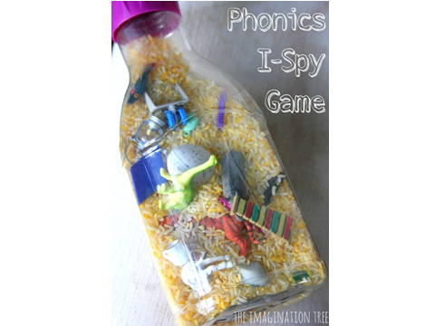

Slide 5
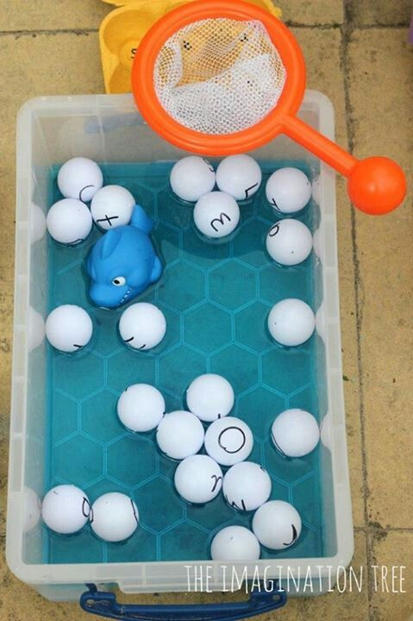

Slide 6
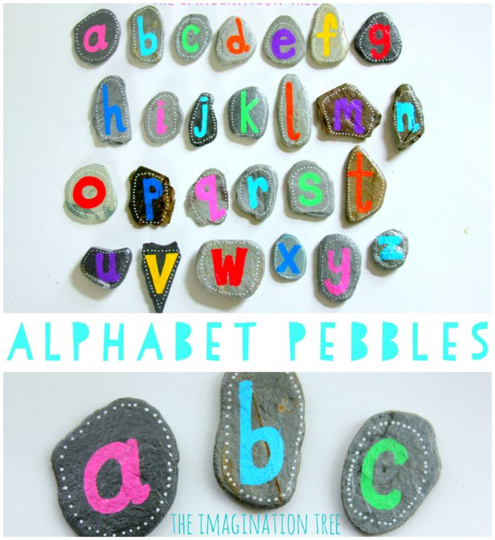

Slide 7
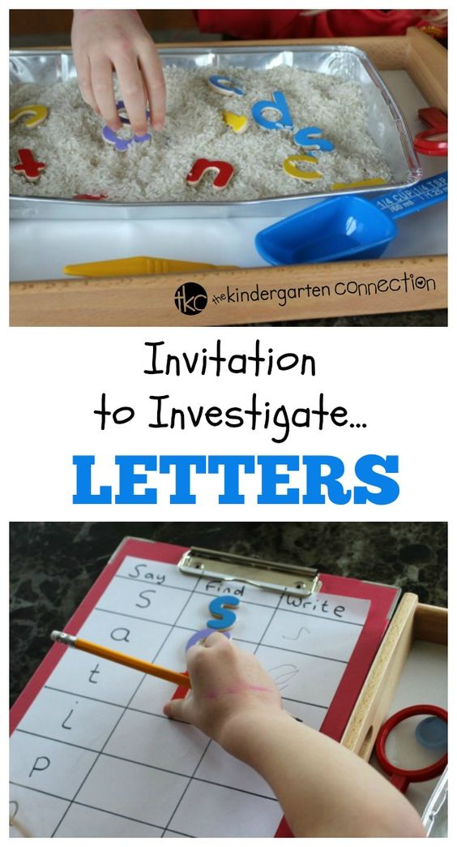

Slide 8
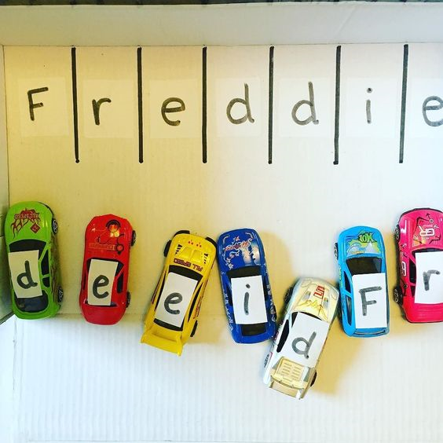

Slide 9
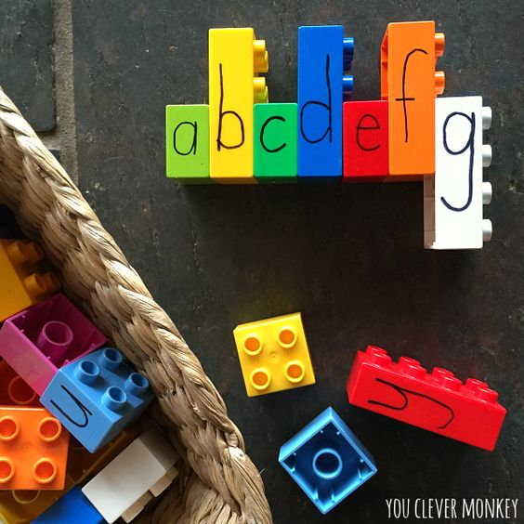

Slide 10
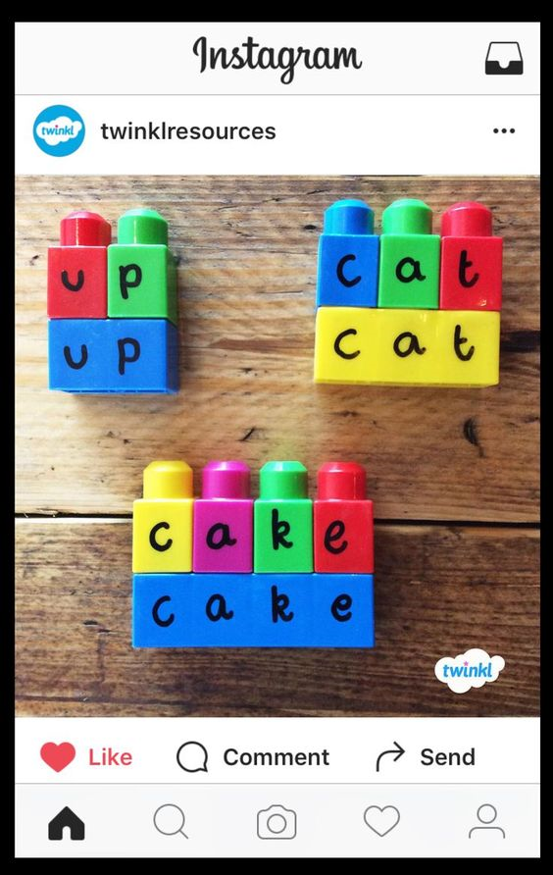

Slide 11
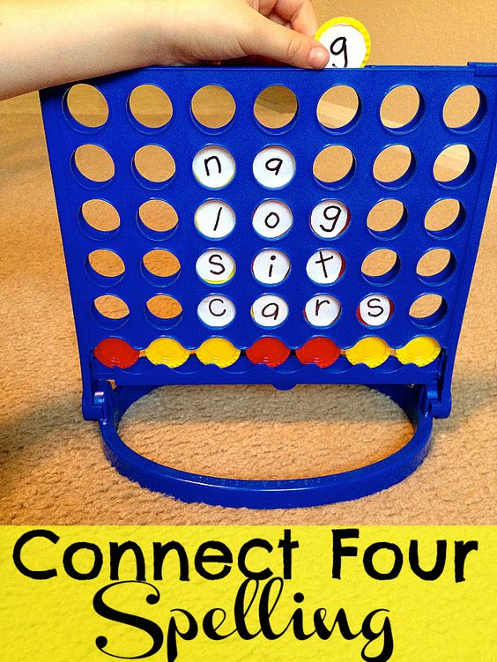

Slide 12
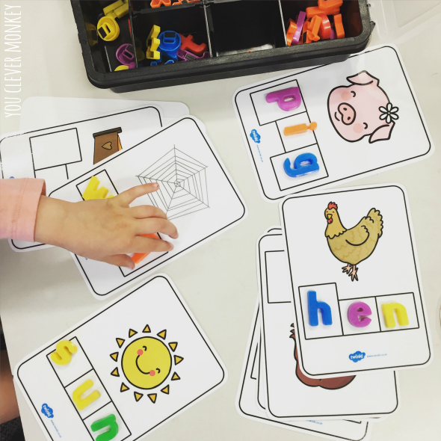

Slide 14
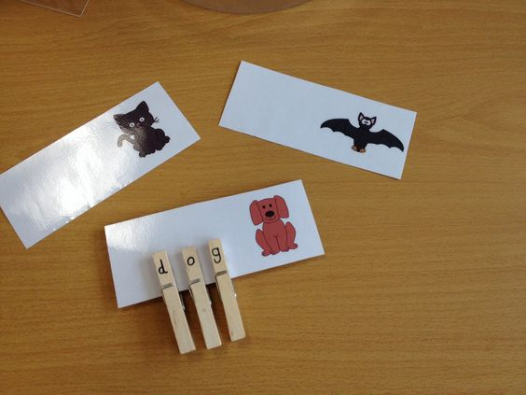

Slide 16
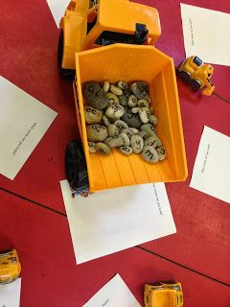

Slide 18
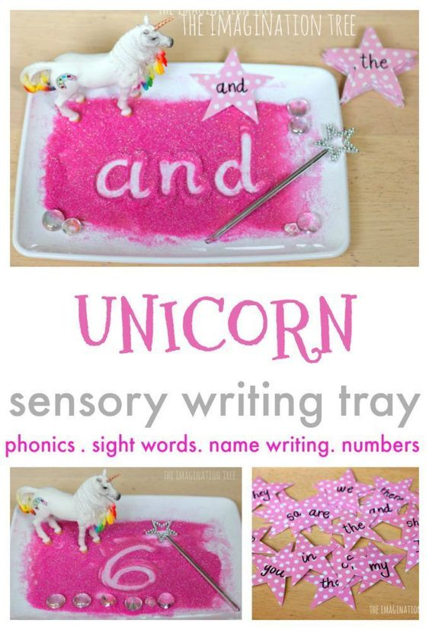

Slide 19
